Slide 1


Model building team progress

Slide 2
Distribution of work
Three main groups:
1- Streamlit UI group
2- interview question generation
3- evaluation group

Slide 3
Streamlit UI group
Members : Swamesh , Trishika, John Irungu, Asiya Shakeel.
Objective: To create the UI for our interview bot using streamlit.
To collect user info.
Chat UI for interview process ( Q&A with STT)
To display evaluation results.

Slide 4
There are two file User_Info.py and Chat_UI_stt.py
User_info .py creates a sidebar view to collect user data Name, Position(dropdown) and Joblink.
Chat_UI_stt.py uses SpeechRecognition library to record and apply STT functionality and saves the converted text file in cwd.
For now it uses few example questions like tell me educational background, work experience and how does it align with the applied position. This is to be replaced with our LLM later on.
Problem: Cannot deploy it on streamlit due to missing portaudio.h file but works fine on local machine.! Need to look out for other ways.

Slide 5
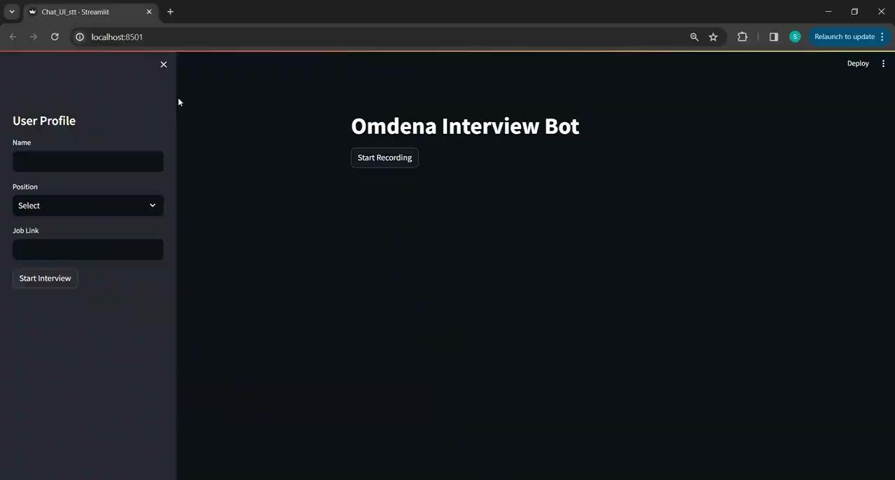

Slide 6
Question Generation group
Members: Abhishek Dutta & Anand Shende
Objective: To create a Python function which can take a job position/role and profile summary of the candidate, as inputs and produce a question bank containing all the relevant questions to be asked to the candidate throughout their interaction with the chatbot.
Tools used: ChromaDB vector DB, LLM, LangChain
Location of code file: GitHub link

Slide 7
Question Generation group
Internal working of the function:
Function receives job position/role and candidate summary as string inputs.
Loads question ‘collection’ into memory from the defined directory - here collection means a ChromDB collection
The function starts with the ‘Introduction’ phase - it means that the function performs a semantic search on the question collection based on the embeddings of the candidate summary and questions in the collection, with metadata filters on position and interview phase
It looks for two introduction phase questions, and if less than two were found, then for the remaining questions it utilises an LLM to generate the question. E.g if only 1 question retrieved, then the other introduction question will be generated by LLM
Then, it does the same process for ‘core’ phase - this includes all interview phases except introduction and conclusion. Four questions expected from this step
At the end, it appends all six questions into a Pandas dataframe and returns it to the program

Slide 8
Question Generation group
Execution flowchart:
Selected questions (Pandas Dataframe)
Function output
Load question collection from ChromaDB directory
Embeddings: Question
Metadata: Position, Interview Phase
Job position/role
Candidate summary
Introduction phase question generation
Core phase question generation
Push 6 questions
Function inputs
Look for 2
Look for 4
Number of semantic search matches found
Number of semantic search matches found
= 2
< 2
= 4
< 4
Push the two questions to question dataframe as it is.
Use LLM with relevant prompt to generate remaining questions
Push the two questions to question dataframe as it is.
Use LLM with relevant prompt to generate remaining questions

Slide 9
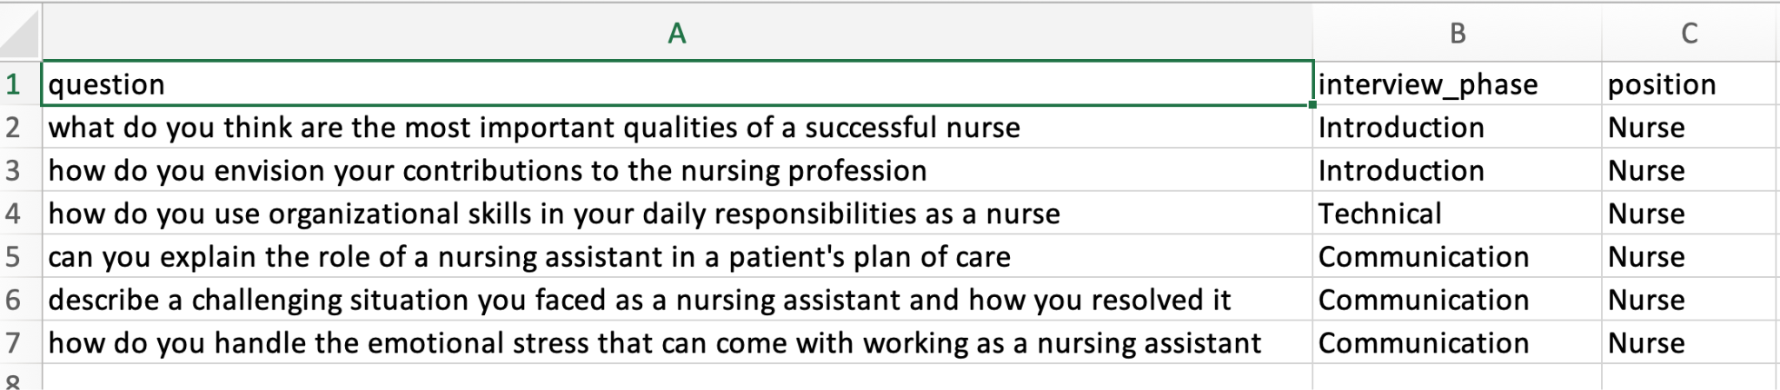
Question Generation group
Updates (as of 22nd Dec’23) and next steps:
The baseline version is complete
Testing on more variety of inputs to be done
Can adjust number of questions as well as deal with conclusion phase
Prompts may be reviewed and tweaked
Example:
Job position: Nurse
Candidate summary: Dedicated and compassionate Registered Nurse with a diverse background in healthcare. Holds a [Degree or Certification] in Nursing from [Institution]. Proven expertise in providing patient-centered care, managing medical records, and collaborating with interdisciplinary teams. Skilled in administering medications, monitoring vital signs, and implementing nursing care plans. Demonstrates strong communication and interpersonal skills, fostering positive relationships with patients, families, and healthcare professionals. Upholds a commitment to continuous learning and professional development. Adept at maintaining a calm and focused demeanor in high-pressure situations. Excited about contributing clinical skills and compassionate care to a dynamic healthcare environment. [Optional: Specify any specializations, such as critical care, pediatrics, or other relevant areas of expertise.]

Slide 10
Evaluation Group
Members:
1- Building the chain pipeline:
a. Ahmed Ahdy
2- Preparing Prompts :
a. Steven
b. Asiya
c. Vijaya
d. Fauzia Khan
Objective:
To Create an evaluation component to evaluate the answer generated by the Candidate

Slide 11
Evaluation Group
Tools:
1- Huggingface
a. Mistral 7b model
b. Tokenizer
c. Bitsandbytes 4bit quantization
d. Pipeline
2- Langchain
a. Agents
b. Chains
i. LLM chain. ii. Simple Sequential Chain. iii. Sequential Chain. iv. Chat prompt tempelate.

Slide 12
Evaluation Group
After experiments with different approaches, ends up using chains from langchain library
1- approach one, RAG system:
a. was suffering from high latency to retrieve information from our base knowledge.
b. some long prompts that contain less and unuseful information may mislead the LLM to handle multiple tasks
2- approach two, using Agents:
a. Also suffering from misleading with long prompts that contain less and unuseful information for handling multiple tasks

Slide 13
Evaluation Group
Last approach, using chains
1- Overcome the high latency
2- Chains give us the flexibility to handle multiple tasks in form of pipelines
3- Make system more scalable by adding more components with different prompts that handle multiple tasks

Slide 14
Evaluation Group
Possible chains pipelines:
Json format contains rating and feedback
Prompt_1
For rating and and providing feedback
Prompt_2
Do the same job but with some differents in the output
Final prompt
Provide a summary for all the prompts
Genereted question and the candidate answer
input
prompt_3
Act as a map reduce function
prompt_4

Slide 15
Evaluation Group
Possible chains pipelines:
Json format contains rating and feedback
Prompt_1
For only rating the answer
Prompt_2
For only evaluation of the candidate’s answer
Genereted question and the candidate answer
Act as a map reduce function
input
Prompt_3
For providing the feedback
Final prompt
Provide a summary for all the prompts

Slide 16
Evaluation Group
Possible chains pipelines:
Json format contains rating and feedback
Prompt_1
For only evaluation of the candidate’s answer
Prompt_2
For only rate the the evaluation
Genereted question and the candidate answer
Act as a map reduce function
input
Prompt_3
For providing the feedback
Final prompt
Provide a summary for all the prompts

Slide 17
RAG system
Additional completed component
Members: Ahmed Ahdy
Objective: to make LLM generate answer based on the candidate question using our base knowledge, that make system more scalable a provides more functionality and features
Tools used: FaissDB vector DB, LLM huggingface, LangChain
Location of code file: Github

Slide 18
RAG System
RAG system pipeline:
Human question
LLM
question
Condence LLM
store
System prompt
Chat history
Relevant splits
answer

